Slide 1

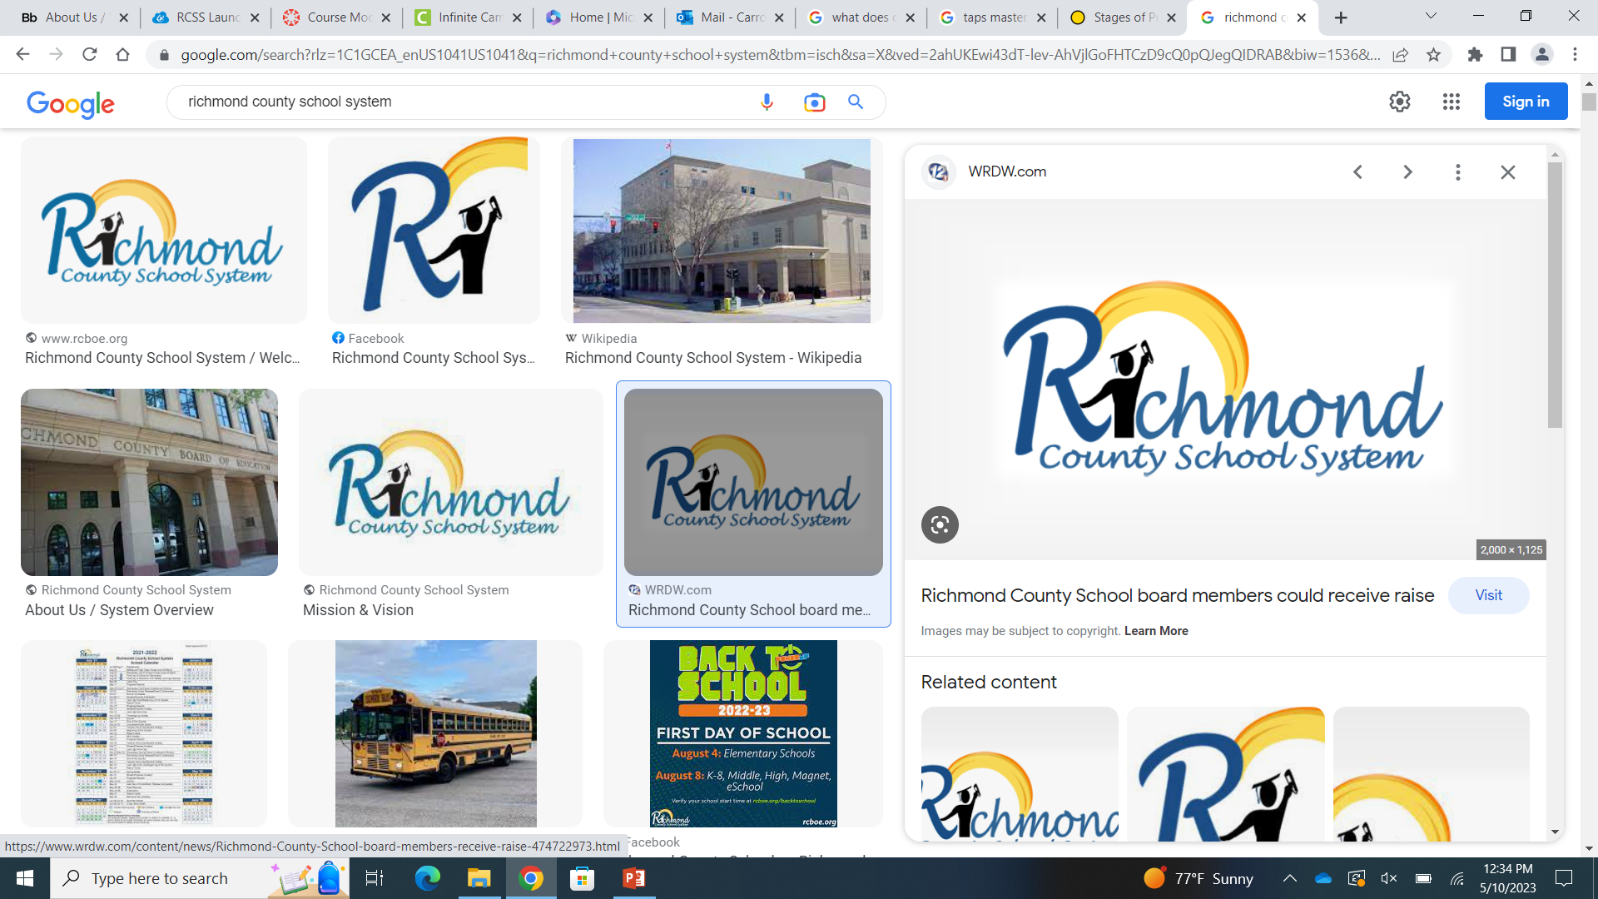
NIET’s TAP System
Overview
Presented by:
Monica Burnett, M. Ed.
Alicia Carroll, Ed. S.

Slide 2
Mission and Vision
Building a globally competitive school system that educates the whole child through teaching, learning, collaboration, and innovation.
The Richmond County School System will provide an equitable education for all students to prepare them for life beyond the classroom.

Slide 3
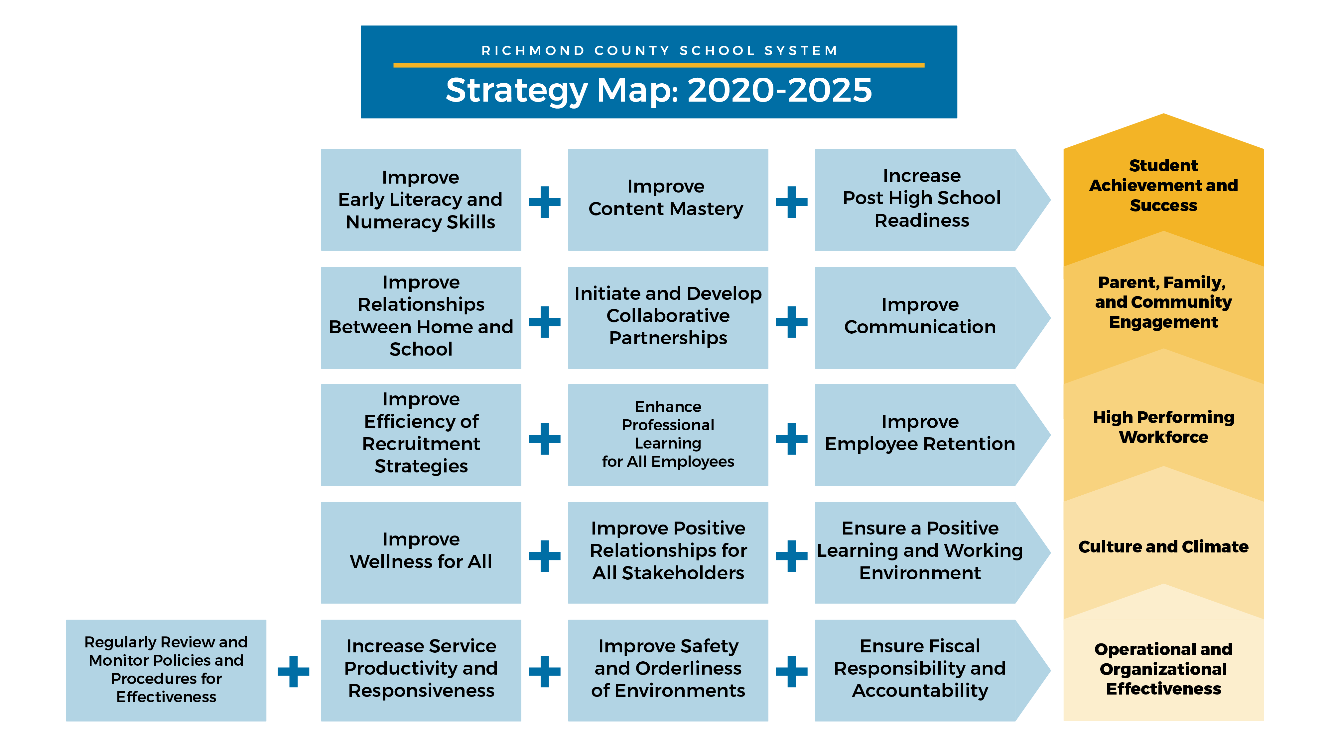

Slide 4
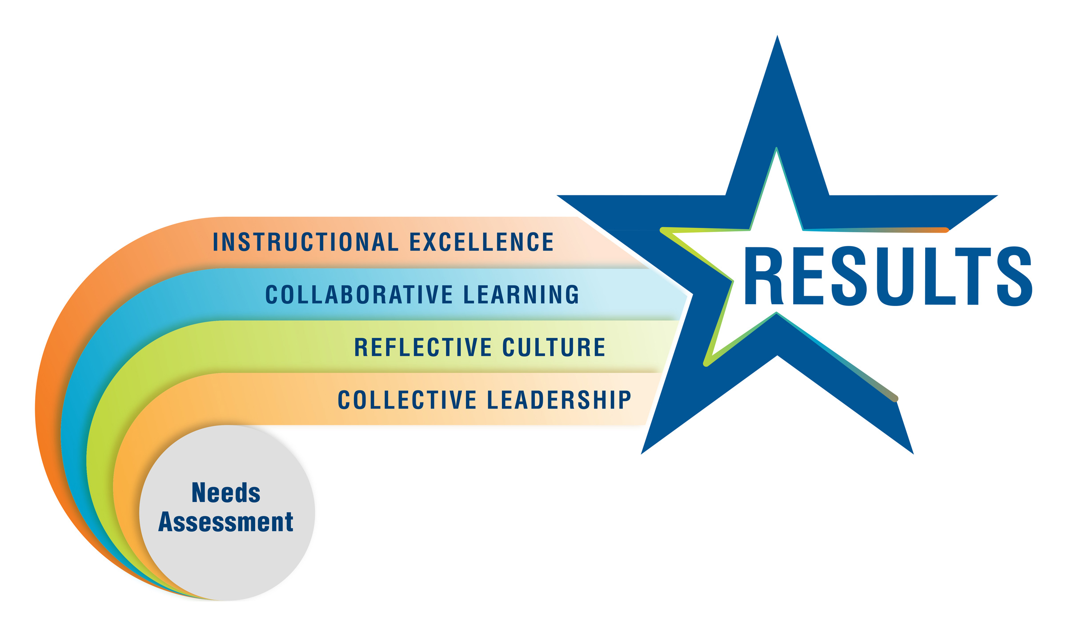
What is NIET?
The National Institute for Excellence in Teaching provides both on-site and online support to states, districts, and schools across multiple aspects of educator effectiveness through educator evaluation, professional development, and teacher leadership.

Slide 5
What is the NIET TAP System? What does TAP provide?
NIET’s TAP System is structured around the core belief that every child deserves an effective educator, in every classroom, every day.
School Improvement Solutions
Teacher and Leader Development
Teacher and Student Advancement
Rubric and Observation Systems
Principal and District Support
Educator Preparation Partnerships
Accelerating Character Education Development (ACED)

Slide 6

What are the SPARTANS connection to the TAP System?
SG1 By the end of the 2023-2024 school year, students performing at levels 3 and 4 on GMAS in American Literature, Algebra I, Biology, and United States History will increase from 5% to 20% (131) percent by expanding the rigor and engagement of Tier 1 instruction.
SG2 By the end of the 2023-2024 school year, the SWD subgroup performing at developing and above on GMAS in American Literature, Algebra I, Biology, and U.S. History will increase 15% (20) by incorporating instructional strategies to promote access to a rigorous curriculum, providing instruction on grade-level, and addressing individual student needs.
Increase teacher effectiveness
Implement high-impact instructional strategies
Build student self-efficacy
Increase student engagement
Increase student achievement

Slide 7
What are the SPARTANS connection to the TAP System?
SG3 By the end of the 2023-2024 school year, the number of behavior incidents will decrease by 50% by implementing PBIS interventions and a tiered system of support.
Redesigning the school climate
  promote a culture conducive to learning
Monitoring school data to plan a tiered support system for behavior
Developing avenues to increase student attendance

Slide 8
The Role of the TAP Master Teacher
With administration
Analyze student data
Develop a school plan utilizing the TAP processes
Create & Institute an academic achievement plan for the school
Research appropriate strategies that target the identified area of student need
With teachers
Oversee the planning, facilitation, and follow-up of cluster meetings
Model lessons (Team-teach)
Field-test appropriate strategies that target the identified area of student need
Observe and provide peer assistance (Coaching)
Evaluate teacher performance utilizing TAP Rubrics

Slide 9
NIET TAP Teaching and Learning Standards Rubric
Designed to support improvements in classroom instruction
Comprehensive focus on 3 domains with ratings of Exemplary (5), Proficient (3), Unsatisfactory (1)
Provides educators with a common understanding and language for
  Designing and planning instruction
  Utilizing effective instructional practices to support student learning
  Creating an equitable and inclusive learning environment

Slide 10


Slide 11
Instruction Domain
Consists of 12 Indicators
Standards and Objectives
  This is the foundation for all other indicators.
  All lessons must have a clear identification of a learning objective aligned with state content standards and the adopted curriculum.
Motivating Students
  Focuses on a teacher’s ability to organize and present the content to motivate students to learn.
  Articulates a teacher’s ability to bring the curriculum to life.
Presenting Instructional Content
  Addresses visuals and a teacher’s ability to teach those standards.
Lesson Structure and Pacing
  Addresses the lesson’s effective segmenting so that sufficient time is allocated to all parts of the lesson to best support student learning.

Slide 12
Activities and Materials
  Addresses the variety and appropriateness of activities and materials that a teacher implements during a lesson.
  Critical that activities and materials support lesson objectives and are challenging for all students.
Questioning
  Aligned with the standards and curriculum.
  Increases rigor and student ownership.
Academic Feedback
  Reciprocal process between teachers and students; students and students; teachers and teachers
  Gauges student learning.
  Adjusts instruction based on student learning.
Grouping
  Addresses the instructional arrangements of the students during a given lesson.
  Focuses on how the students will be grouped for the instruction and activities of the lesson.

Slide 13
Teacher Content and Knowledge
  Addresses the teacher’s knowledge of the content and the ability to implement strategies to support student learning.
  Addresses the teacher’s ability to connect the content being taught to other ideas and concepts.
Teacher Knowledge of Students
  Focuses on how well a teacher knows their students and their learning styles and interests.
Thinking
  Develops multiple skills in thinking and problem-solving enriches the learner’s ability to manage complex tasks and higher levels of learning.
Problem-Solving
  Develops multiple skills in problem-solving enriches the learner’s ability to manage complex tasks and higher levels of learning.

Slide 14


Slide 15
Designing and
Planning Domain
Consists of 3 Indicators
Instructional Plans
  Contributes to effective and efficient learning experiences for students and highly engaged classrooms.
  Plans for how students will demonstrate mastery.
Student Work
  Requires consideration of the content-specific work and assignments students will complete during the lesson.
Assessment
  Provides examples of high-quality assessments and how they should be utilized.

Slide 16


Slide 17
Environment Domain
Consists of 4 Indicators
Expectations
  Ensures the establishment of clear and rigorous academic expectations.
Engaging Students and Managing Behavior
  Establishes a culture where students understand how their own actions in the classroom help or hinder learning.
Environment
  Establishes a classroom environment that optimizes learning and empowers inclusivity
Respectful Culture
  Develops a safe space that is conducive to learning.

Slide 18

References
Rcboe.org
Niet.org

